Slide 1
More Clocks and Timers
Lecture #11

Slide 2
MSP430F5529 Clock System
>> MSP430 Clock module is very capable, wide variety of clocking options under software control
>> Unified Clock System (UCS) --5 possible Clock sources
XT1CLK = LF Crystal 32,768 Hz REF0CLK = Internal osc., 32768 Hz
XT2CLK = 4MHz crystal
DCOCLK = Internal Digitally Controlled Oscillator (frequency selectable) (can use LF and HF crystals as source)
VLOCLK = Internal osc., ~10KHz
>> Provides 3 clock signals to CPU and peripherals (On Reset theyDEFAULT to the following... KNOW THESE!)
ACLK= Auxillary Clock = XT1CLK = 32768 Hz
MCLK= Master Clock (CPU) = DCOCLK = 32*XT1CLK = 1.048576 MHz
SMCLK = Sub-main Clock = DCOCLK = 1.048576 MHz
>> Clock sources/speeds for CPU and peripherals are SOFTWARE selectable
Controlled through 9 registers (see User's Guide!)

Slide 3
TIMERS
>> Digital circuit block that counts clock ticks
>> Digital circuit that is separate from CPU
3.3 V
4-bit counter
clk
0000
0 V
4-bit count
0001
0010
0011
. . .
1111
0000

Slide 4






TIMER - Modes
Unidirectional mode (Up mode in MSP430) = Count from 0 to a programmer set maximum count
$t_{int}$ = time between interrupts
$$MAX_CNT$$
$$t_{int}=\left(MAX_{CNT}+1\right)×t_{clk}$$
$$t_{clk}=1/f_{clk}$$
$$0$$
$$t_{int}$$

Slide 5



TIMER - Modes
Continuous Mode = Counts from 0 to Full Count of timer (8, 12 or 16 bits)
$t_{int}$ = time between interrupts
$$FULL_CNT$$
$$t_{int}=\left(2^{16}\right)×t_{clk}$$
$$t_{clk}=1/f_{clk}$$
$$0$$
$$t_{int}$$

Slide 6


TIMER - Modes
Up/Down mode = Counts from 0 to selected Max Count then back to 0
$t_{int}$ = time between interrupts
>> Timers typically generate an Interrupts (to the CPU) at the transition back to 0
$$MAX_CNT$$
$$t_{int}=\left(2×MAX_{CNT}\right)×t_{clk}$$
$$t_{clk}=1/f_{clk}$$
$$0$$
$$t_{int}$$

Slide 7
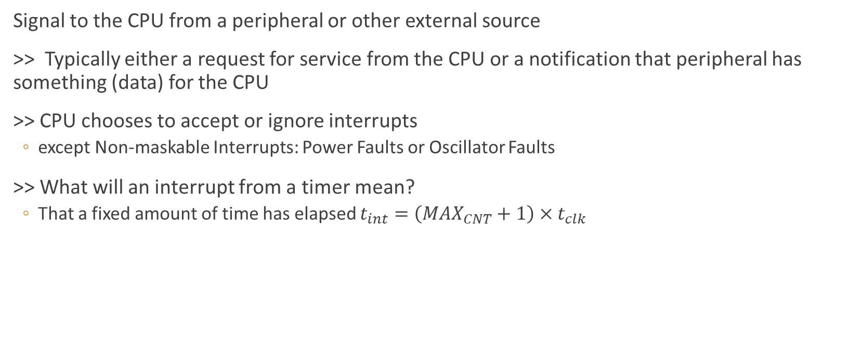
Interrupts
Signal to the CPU from a peripheral or other external source
>> Typically either a request for service from the CPU or a notification that peripheral has something (data) for the CPU
>> CPU chooses to accept or ignore interrupts
except Non-maskable Interrupts: Power Faults or Oscillator Faults
>> What will an interrupt from a timer mean?
That a fixed amount of time has elapsed $t_{int}=\left(MAX_{CNT}+1\right)×t_{clk}$

Slide 8
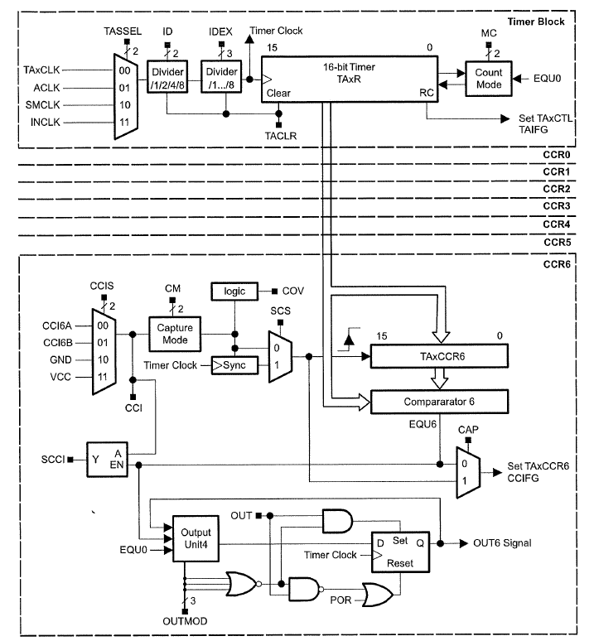

Slide 9
MSP430F5529 - General Purpose Timers
>> Timer B
Used by Graphics Library
7 Capture and Compare registers
PWM used for Buzeer
>> Timer A0
PWM
>> Timer A1
PWM
Used by LCD
>> Timer A2
We will used for measuring time
3 Capture and Compare registers

Slide 10
MSP430F5529 - General Purpose Timers
>> Plus a Basic Timer (w/ Real-time clock features)
>> And a Watchdog Timer....
When it's ON, the WDT must continually have its count reset within the program
If the WDT is ON and its count gets to 0 it will reboot the MSP430!
Which is why the first instruction in your main()should be
WDTCTL = WDTPW + WDTHOLD; // Stop watchdog timer

Slide 11
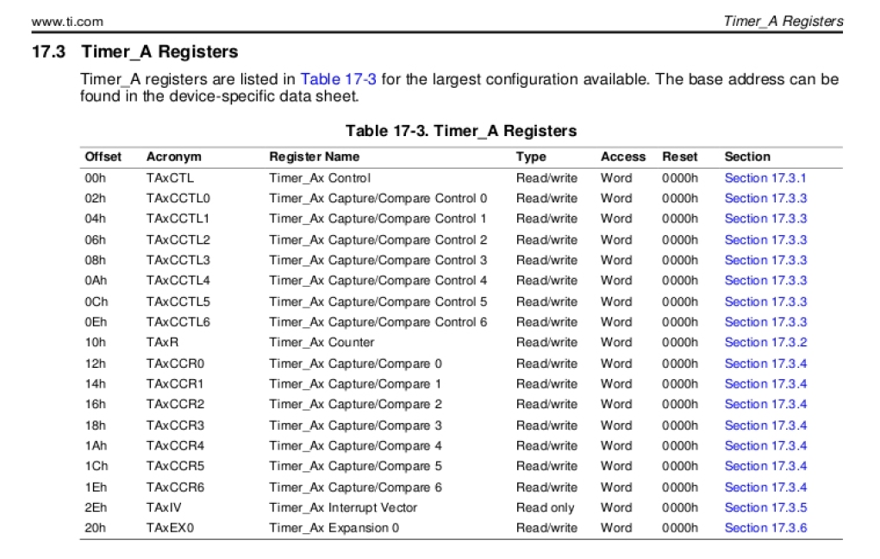
MSP430F5529 - General Purpose Timers
>> Like the '430 Clock module, the Timers are highly (almost infinitely) configurable!
>> We will stick to the basics –they can be confusing enough!
Add complexity ONLY when needed!

Slide 12
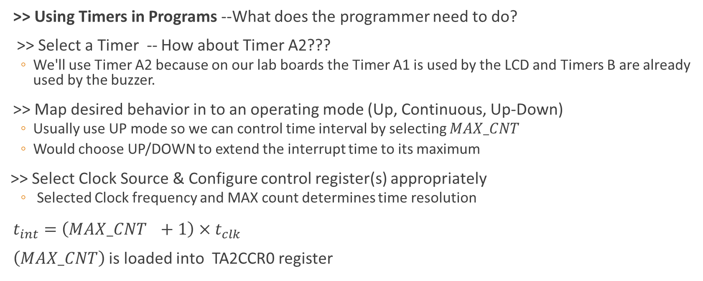
MSP430F5529 - General Purpose Timers
>> Using Timers in Programs --What does the programmer need to do?
>> Select a Timer -- How about Timer A2???
We'll use Timer A2 because on our lab boards the Timer A1 is used by the LCD and Timers B are already used by the buzzer.
>> Map desired behavior in to an operating mode (Up, Continuous, Up-Down)
Usually use UP mode so we can control time interval by selecting $MAX_CNT$
Would choose UP/DOWN to extend the interrupt time to its maximum
>> Select Clock Source & Configure control register(s) appropriately
Selected Clock frequency and MAX count determines time resolution
$t_{int}=\left(MA{X_CNT}_{}+1\right)×t_{clk}$
$\left(MAX_CNT\right)$ is loaded into TA2CCR0 register

Slide 13
MSP430F5529 - General Purpose Timers
--Write Interrupt Service Routines (ISR) and enable interrupts
>> In C, you need implement ISR function and also do global interrupt enable
>> Later in main() you must enable interrupts…
// Example syntax for Timer A2 interrupt service routine
#pragma vector=TIMER2_A0_VECTOR
__interrupt void Timer_A2_ISR(void)
{
// Do something
. . .
}
// Using msp430.h definitions
_BIS_SR(GIE); // Global Interrupt enable

Slide 14


Interrupt Service Routine
But how do you decide what the timer settings should be and what the ISR should do?
Example: Implement a stop watch that measures seconds and hundredths of seconds using TimerA2. (Example code posted)
First question, how will we measure the passage of 0.01 seconds?
By counting clock ticks
How many clk ticks 0.01 sec?
Depends
$$t_{clk}$$
$$f_{clk}$$

Slide 15

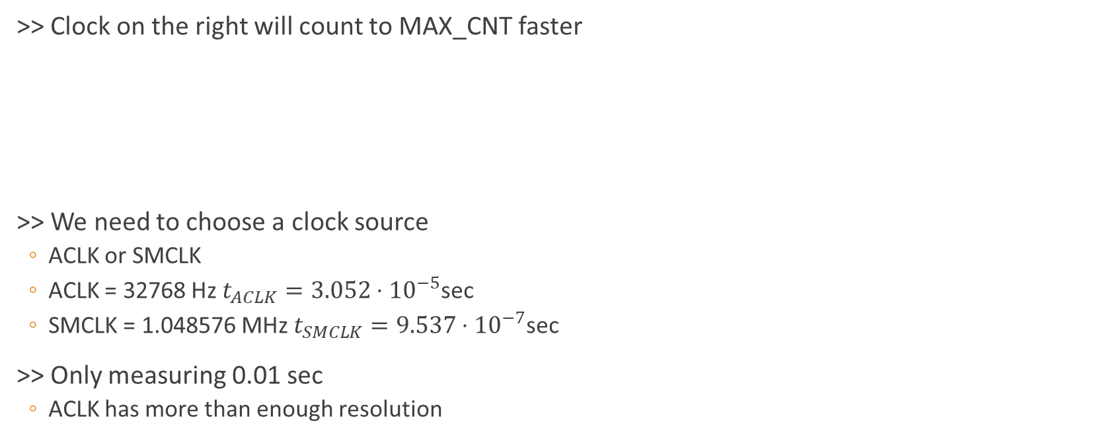

Interrupt Service Routine
>> Clock on the right will count to MAX_CNT faster
>> We need to choose a clock source
ACLK or SMCLK
ACLK = 32768 Hz $t_{ACLK}=3.052⋅{10}^{−5}$sec
SMCLK = 1.048576 MHz $t_{SMCLK}=9.537⋅{10}^{−7}$sec
>> Only measuring 0.01 sec
ACLK has more than enough resolution
$$t_{clk}$$
$$t_{clk}$$

Slide 16

Initializing control registers
$t_{int}=0.01=\left(MAX_CNT+1\right)×(1/32768)$
$327.68=\left(MAX_CNT+1\right)=328$
TA2CTL =
TA2CCR0 = 327; // 327+1 = 328 ACLK tics = ~1/100 seconds
TA2CCTL0 = CCIE; // TA2CCR0 interrupt enabled
Use ACLK
Divider=1
Up Mode
TASSEL_1
+ ID_0
+ MC_1
MAX_CNT
Enable interrupts

Slide 17
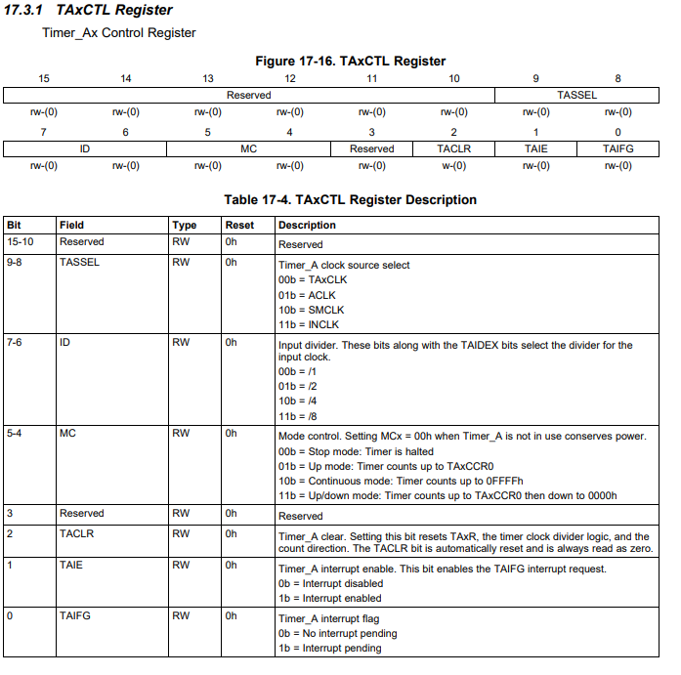

Slide 18
Interrupt Service Routine
>> What will it mean when we get an interrupt from TimerA2? What should the ISR do?
Nothing unless we also enable interrupts for the CPU within our program!
_BIS_SR(GIE)
>> Each interrupt means that 327+1 clock ticks have elapsed = ~0.01 second using ACLK
>> TimerA2 ISR should count how many interrupts have occurred!
Global variable timer is a count of the number of 0.01 second intervals that have elapsed
#pragma vector=TIMER2_A0_VECTOR
__interrupt void Timer_A2_ISR(void){
timer++;
}

Slide 19
Interrupt Service Routine
>> What does the CPU do when it receives the interrupt (assuming interrupts are enabled) and between interrupts?
>> Arrival of INTERRUPT is Asynchronous to program execution
>> Never know when INT will occour
Flow of main program
Main
ISR
ISR

Slide 20
Interrupt Service Routine
unsigned int timer; // global timer count variable
while(1) // Forever loop of the stop watch{
. . .
chkBtns(); // check for button press
if(button1){
timer_on=0;
stoptimerA2(1); // reset timer
P1OUT =~BIT0; // turn LED off
}
if(button2){
timer_on=1;
runtimerA2(); // starts timer
P1OUT =~BIT0; // turn LED off
GrClearDisplay(&g_sContext);
}
if (timer_on)
if (timer%10==0) // update display every 1/10th sec
displayTime(timer);
} /* End while(1) loop */
>> CPU finishes current assembly instruction then foes to ISR like it was a function call
>> After ISR complete, CPU resume execution where it left off!
INT occurs
INT occurs
INT occurs

